Slide 1
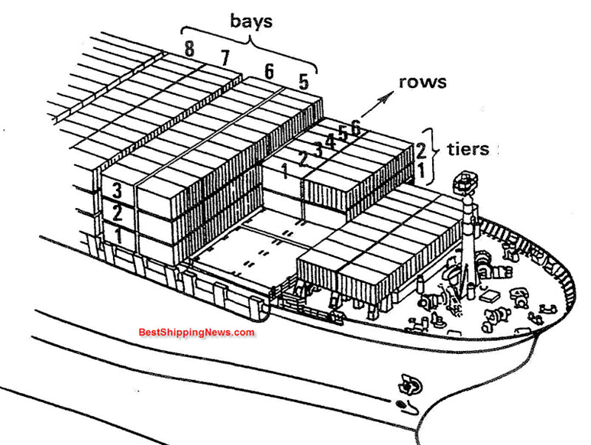
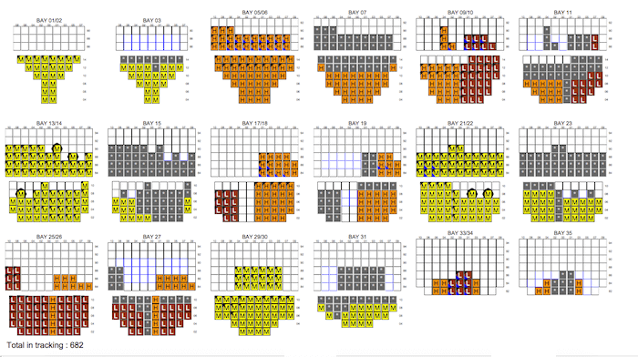
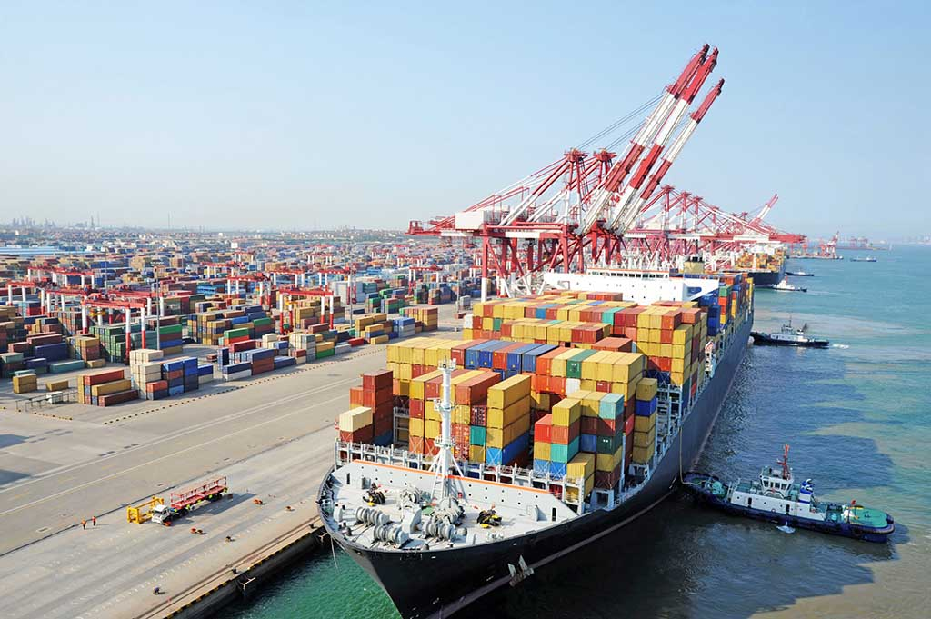
Container Ship Stowage Planning
Aj.Sirion Son-ong

Slide 2
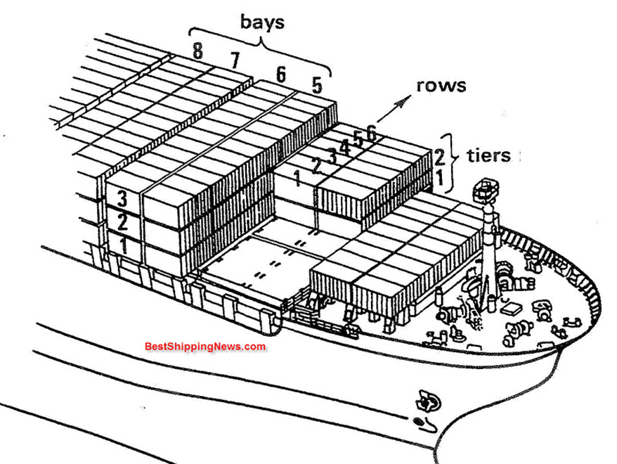
Placement of containers in cargo ships
bay row tier system
Bays
Rows
Tiers

Slide 3
A bay is a long line (row). Arranging containers in the ship's order, with the beginning of the bay at 01 02 03 04……. Bay 01 starts at Bow (bow) and Bay ends at Stern (stern). ship)
where 20 must be ensured to be an even number (odd number), while the 40 box is assigned to an even number (even number).
BOW
Stern

Slide 4
20 Container loaded
Theoretically, the thirty-eight bays could be numbered continuously from 1 to 38. However, that would only be sensible if only 20' containers could actually be loaded

Slide 5
40 Container loaded
If the ship could only transport 40' containers, the nineteen bays could be numbered continuously from 1 to 19.

Slide 6
Bay numbering system
Since, however, the ship can transport both 20' and 40' containers, the bay spaces for 20' containers are numbered throughout fore to aft with odd numbers, i.e. in this case 01, 03, 05 and so on up to 75. The bay spaces for 40' containers are numbered throughout with even numbers: 02, 04, 06 and so on up to 38.
The purple 20' container in the first bay has the bay number 01. The light-brown 20' container in the second bay has the bay number 03 and the light-blue 40' container, which occupies a space in the first and second bays, has the bay number 02. The magenta-colored container has the bay number 25, the dark-green number 27 and the light-green number 26.

Slide 7
Bay numbering system
Since, however, the ship can transport both 20' and 40' containers, the bay spaces for 20' containers are numbered throughout fore to aft with odd numbers, i.e. in this case 01, 03, 05 and so on up to 75. The bay spaces for 40' containers are numbered throughout with even numbers: 02, 04, 06 and so on up to 38.
The purple 20' container in the first bay has the bay number 01. The light-brown 20' container in the second bay has the bay number 03 and the light-blue 40' container, which occupies a space in the first and second bays, has the bay number 02. The magenta-colored container has the bay number 25, the dark-green number 27 and the light-green number 26.

Slide 8
Bay numbering system
Since, however, the ship can transport both 20' and 40' containers, the bay spaces for 20' containers are numbered throughout fore to aft with odd numbers, i.e. in this case 01, 03, 05 and so on up to 75. The bay spaces for 40' containers are numbered throughout with even numbers: 02, 04, 06 and so on up to 38.
The purple 20' container in the first bay has the bay number 01. The light-brown 20' container in the second bay has the bay number 03 and the light-blue 40' container, which occupies a space in the first and second bays, has the bay number 02. The magenta-colored container has the bay number 25, the dark-green number 27 and the light-green number 26.

Slide 9
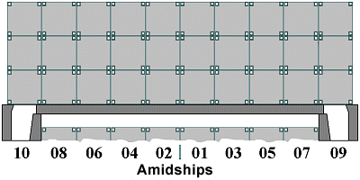
Row is the arrangement of containers according to the width of the ship. The container on the left (Port Side) is assigned an even number 02, 04, 06, 08…. The container on the right (Starboard) is assigned an odd number 01, 03, 05, 07, 09…
(Port Side)
(Starboard)

Slide 10
Boats with an even number of rows will use the center line as the center point dividing the starboard side - right side of the ship.
10 Rows
Center line

Slide 11
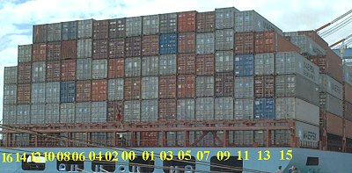
But if the boat has an odd number of rows, the middle row will be used as the center point to divide the starboard side - the right side of the boat, with the middle row set to be Row 00.
17 Rows

Slide 12
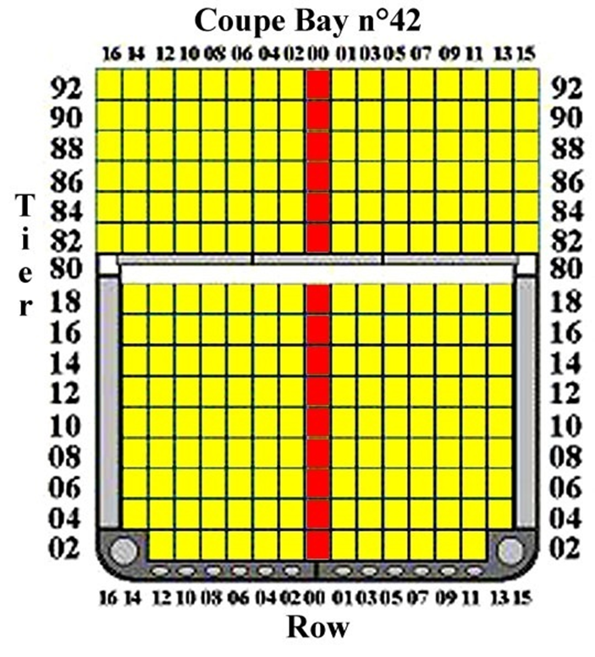
Tier is the height (level) of stacked containers, use an even number.
The tier under deck (under deck) starts at 02, 04, 06….
As for the Tier on the deck (on deck), it will start at 82, 84, 86…

Slide 13
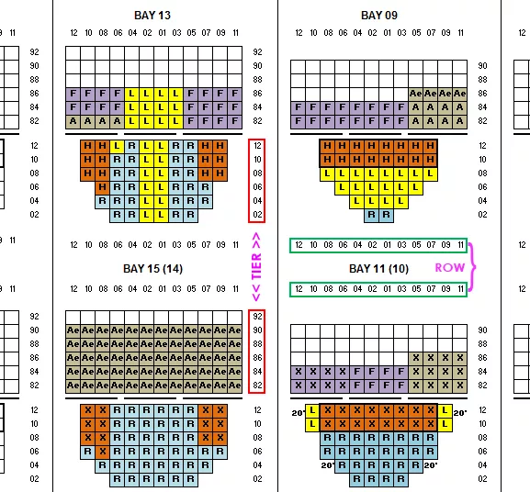
Bay Plan, Profile – is the cross sectional view of the entire ship covering both the deck and under-deck of the ship

