Slide 1
TOM 2204 Road Safety Administration
Topic 2
setting objectives
Professor piyamas klakhaeng

Slide 2
setting objectives
setting objectives
Strategic objectives in road safety are established by senior management. It describes the safety practices that the transport business expects to achieve in accordance with the vision and HSE policy of the transport business.

Slide 3
Objective setting requirements
Criteria for determining road safety objectives and goals
Information and issues to consider
Road safety policy.
Road safety laws and regulations.
Significant road safety issues.
Financial suitability.
Technological suitability.
Procedures and claims procedures for businesses.
The point of view of interested parties.

Slide 4
Objective setting requirements
Criteria for determining road safety objectives and goals
Objectives and goals of road safety of the Company May focus on the following areas:
Reducing the unsafe effects and road safety impacts caused by The company's transportation activities.
Impact protection against road safety.
Make the most of resources.
Raise road safety awareness among all employees in the organization.
Improving the road safety management system.
Direct and indirect road safety activities for society.

Slide 5
Objective setting requirements
Criteria for determining road safety objectives and goals
Objectives and goals of road safety of the Company It may be defined in the following ways:
Road Safety Management Performance Indicators.
Criteria for success factors according to the specified work plan
Set standards and procedures to meet the criteria. and target strategy
Road safety target objectives are reviewed at least once a year by the Executive Committee.

Slide 6
เป้าหมายและตัวชี้วัดประสิทธิภาพด้านความปลอดภัยทางถนน

Slide 7
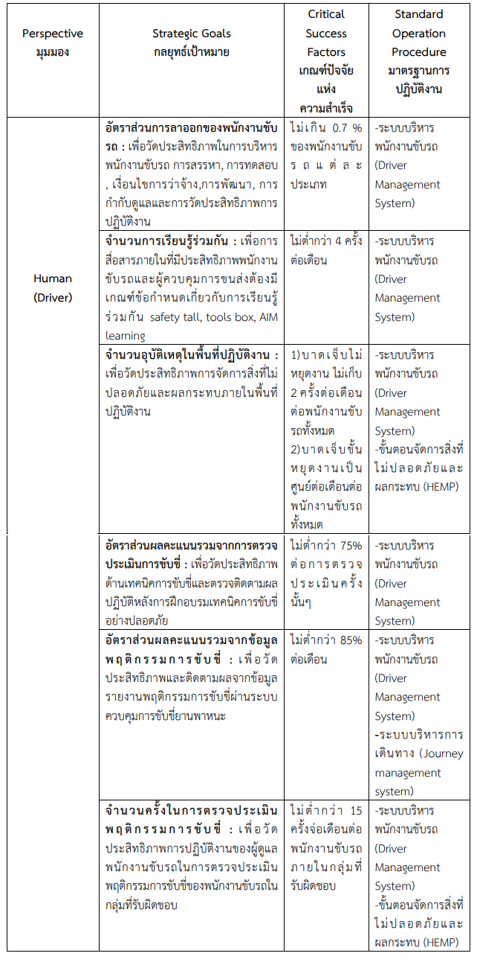
เป้าหมายและตัวชี้วัดประสิทธิภาพด้านความปลอดภัยทางถนน
Human (Driver)

Slide 8
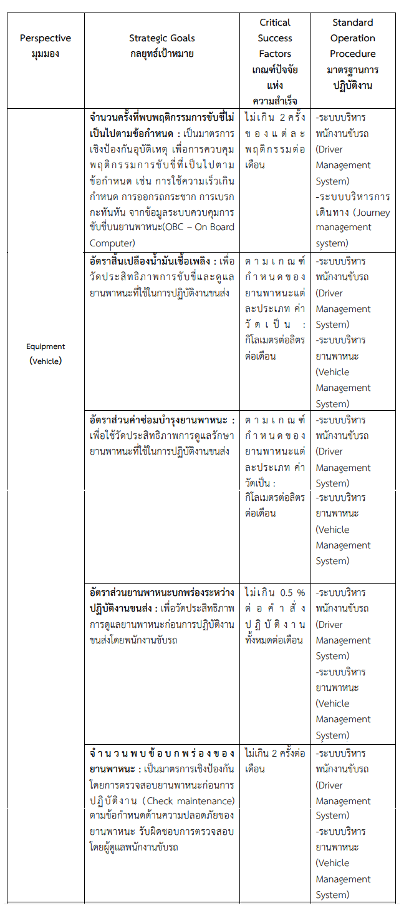
เป้าหมายและตัวชี้วัดประสิทธิภาพด้านความปลอดภัยทางถนน
Equipment (Vehicle)

Slide 9
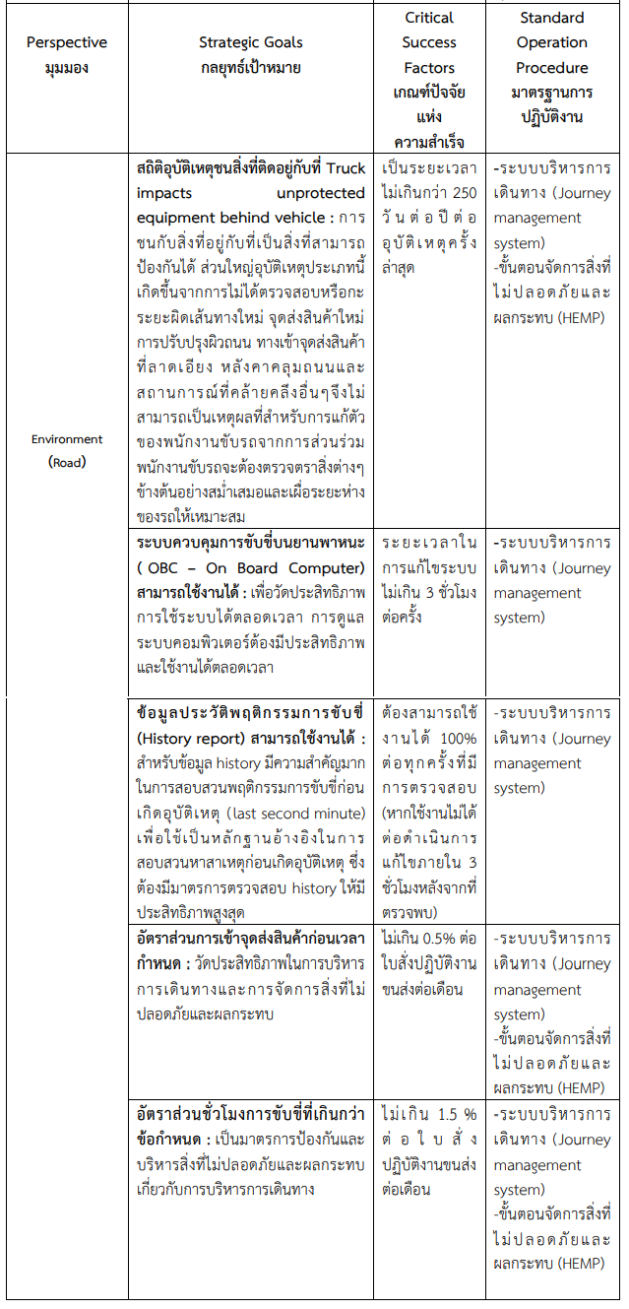
เป้าหมายและตัวชี้วัดประสิทธิภาพด้านความปลอดภัยทางถนน
Environment (Road)

Slide 10
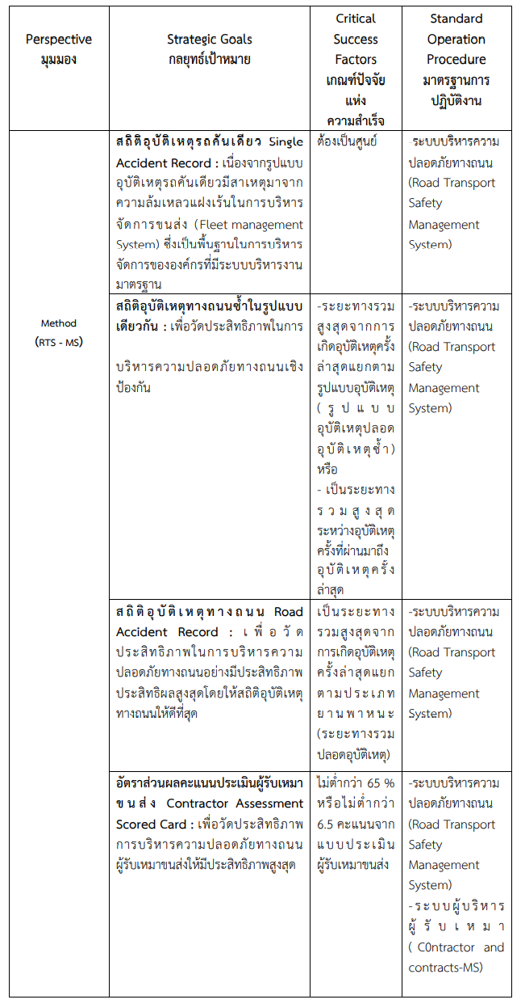
เป้าหมายและตัวชี้วัดประสิทธิภาพด้านความปลอดภัยทางถนน
Method (RTS - MS)

Slide 11
TOM 2204 Road Safety Administration
Topic 3
Road safety planning
Professor piyamas klakhaeng

Slide 12
Road safety planning
security issues road safety planning.
Setting criteria for assessing road safety issues.
Road Safety Issue Identification and Assessment.
Regulating and managing road safety issues register.

Slide 13
Road safety laws and regulations.
1. Registration of road safety regulations and laws.
Road safety officers are informed of the law. Requirements or rules for security Road safety by getting information from various sources:
Royal Gazette
Documents from relevant government agencies.
Websites of relevant government agencies.
A book or document that compiles road safety laws.

Slide 14
Identifying the relationship between road safety issues and regulations and legislation
Road safety officials have identified the relationship between safety issues and road safety with Comply with the road safety regulations and laws of the activities for which they are responsible. Registered on the Road Safety Issues Register.
Road safety officials must review the regulatory register. regulations and the law road safety vs work activities always working in the responsibility

Slide 15
กระบวนการบริหารสิ่งที่เป็นอันตรายและผลกระทบ
การบริหารสิ่งที่เป็นอันตรายและผลกระทบไปใช้กับการปฏิบัติการขนส่งของธุรกิจขนส่งเนื้อหาเป็น แบบทั่วๆไป และอาจไม่ครอบคลุมทุกหัวข้อที่เกี่ยวกับการบริหารความปลอดภัยของธุรกิจขนส่ง
การระบุและ จัดการสิ่งที่เป็นอันตรายและผลกระทบที่เกิดขึ้นในระหว่างปฏิบัติการขนส่งบนถนนเป็นส่วนสำคัญใน การบริหารความปลอดภัย

Slide 16
Basic steps in hazard management
- Identify
- Assess
- Control
- Recovery

Slide 17
Principles for identifying hazards and hazardous events.
Examples of dangerous things include:
Vehicle kinetic energy
kinetic energy of other vehicles
kinetic energy/potential energy from the cargo carried in the vehicle
Low-level high-voltage power lines
falling stone
driving through flooded areas
Robbery, hijacking 23
working at height

Slide 18
Examples of Hazardous Events.
Collision collisions with other transport vehicles
Vehicle/Pedestrian collisions
overturned car
Falling under the load of another vehicle

Slide 19
Identify signs of danger
Examples of warning signs in land transport operations include:
Other vehicles
Alcohol and drug use
Drug treatment
Sleep deprivation
Poor vision
Disqualified tires

Slide 20
Warning signs related to driving can be divided into 3 major items:
1. driver
2. vehicle
3. environment

Slide 21
1. Driver
Accident reports indicate that human behavior is the primary cause of up to 90% of road accidents.
The use of medication prescribed by a doctor may have some effect on the driver.
Note: Patients should not drive for 48 hours after receiving anesthesia or strong sedatives in minor surgery Drinking alcohol will cause can worsen symptoms

Slide 22
Errors and Violations
A dangerous mistake is a bad decision. Whether as a result of one person's action or another, events that can cause dangerous errors include:
- Does not give warnings to pedestrians and road users
- miscalculated the speed of the car coming in a close manner.
- Didn't check by looking in the mirror before taking any action.
- Didn't signal stop or ask for way.
- stop the car suddenly.
- Not being aware of potentially dangerous road conditions until it's too late.
- Not being sufficiently careful with the car in front

Slide 23
2. Vehicle
5% of road accidents are caused by bad vehicles. Vehicle-related danger signs include:
- The criteria and procedures for selection are inadequate.
- Attributes are not enough. bad design.
- Lack of desired safety features (e.g. side and rear protection).
- Inadequate maintenance (tires are defective or torn).
- Procedures for dealing with defects are inadequate.
- expired (vehicle becomes "not suitable for needs")
- Overloading or unsuitable weight of the load
- poor maintenance

Slide 24
3.External environment
50% of fatal accidents are caused by external circumstances. Danger signals from the external environment can be divided into 3 categories: Society
Infrastructure
Climate and natural road safety

Slide 25
Risk Assessment
The degree of risk associated with each hazard can be quantified. After assigning probabilities and detailing the possible outcomes, probabilities and outcomes was valued by an in-depth review. and by analyzing serious and likely fatal incidences that occurred

Slide 26
Controls to reduce risk
When faced with unacceptable conditions Specific measures to mitigate risks will be developed and implemented. Risk mitigation measures are in place to prevent incidents and others and to minimize their potential consequences.

Slide 27
Reducing violence on roads
in view of the high potential risks Violence should be minimal. So if there is a way Avoid others such as Transportation by pipelines, trains, ships should be used according to local conditions and occasions.

Slide 28
Work-level risk reduction measures
- The resourcefulness of the transportation business staff.
- Use only approved subcontractors.
- Efficient driver management
- Efficient vehicle management
- Efficient fleet management

Slide 29
Recovery
Use a seat belt
Vehicle safety characteristics
Immediate Crisis Management Team Calling System and Recovery Operations Procedures
Emergency response team
Clear management
Emergency Medical Assistance Plan
Clear instructions for the driver
First aid training for drivers and rehabilitation/rehabilitation training
supply first aid kit firefighting tools and vehicle communication system

Slide 30
Road safety planning
The establishment of road safety planning and procedures aims to: Improve road safety performance by implementing strategic goals, plans and Strategic Objective Guidance Procedures.

Slide 31
End.

